Slide 1
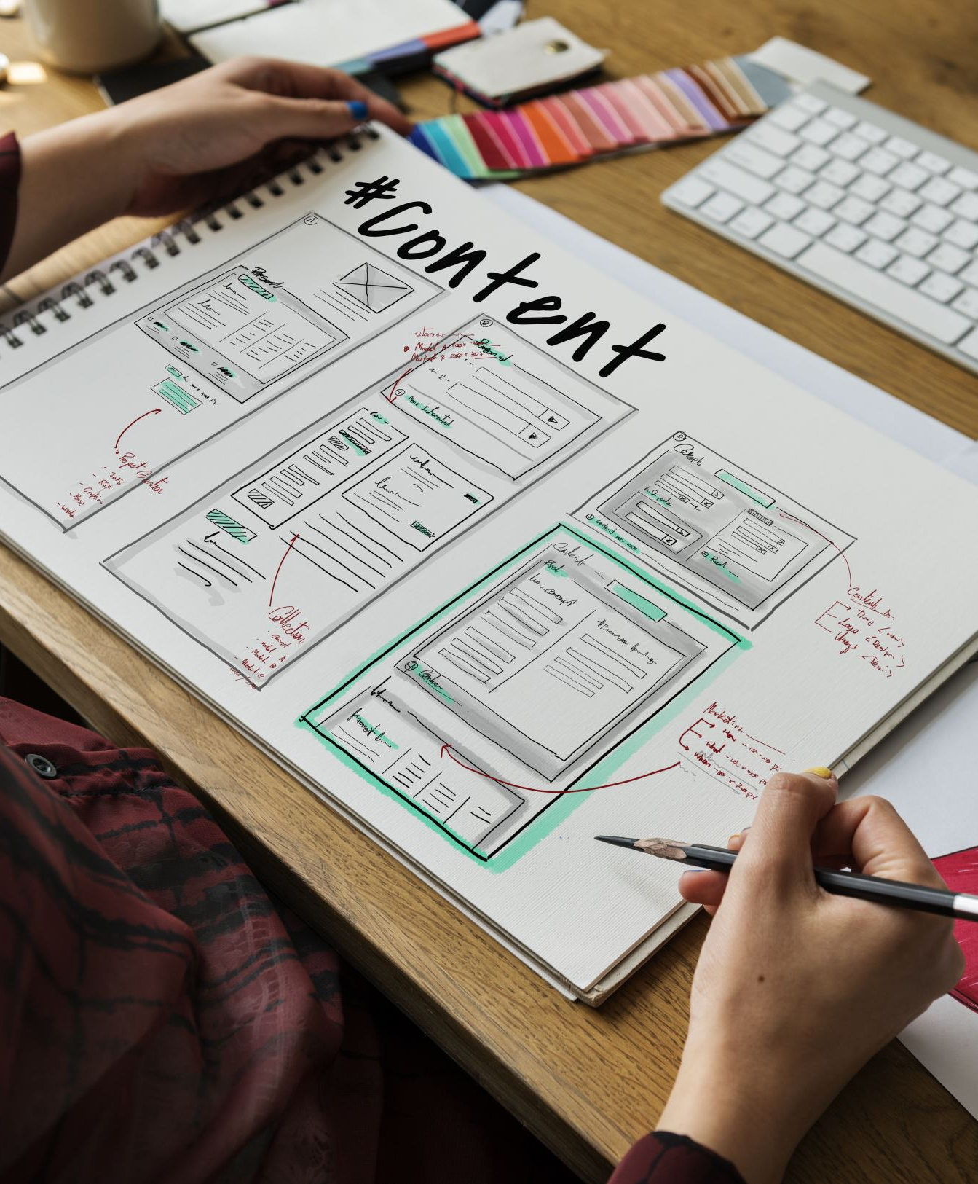
~ Stop N Save ~ Marketing Plan

Slide 2
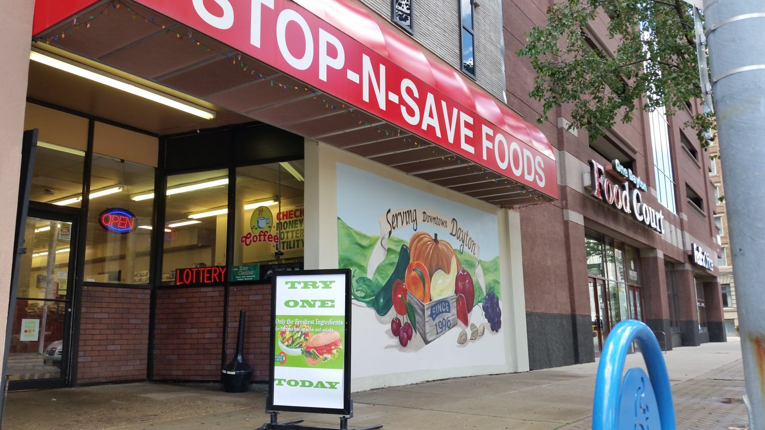
What is Stop N Save?
First opened in 1997, located in Downtown Dayton
The store is run and operated by a father-son partnership
It’s a business providing groceries and home necessities

Slide 3
Goals & Objectives
Form the brand’s identity
01
Build a prominent online presence
02
Develop a successful marketing plan
03
Expand the Reach to Further Customers
04

Slide 4
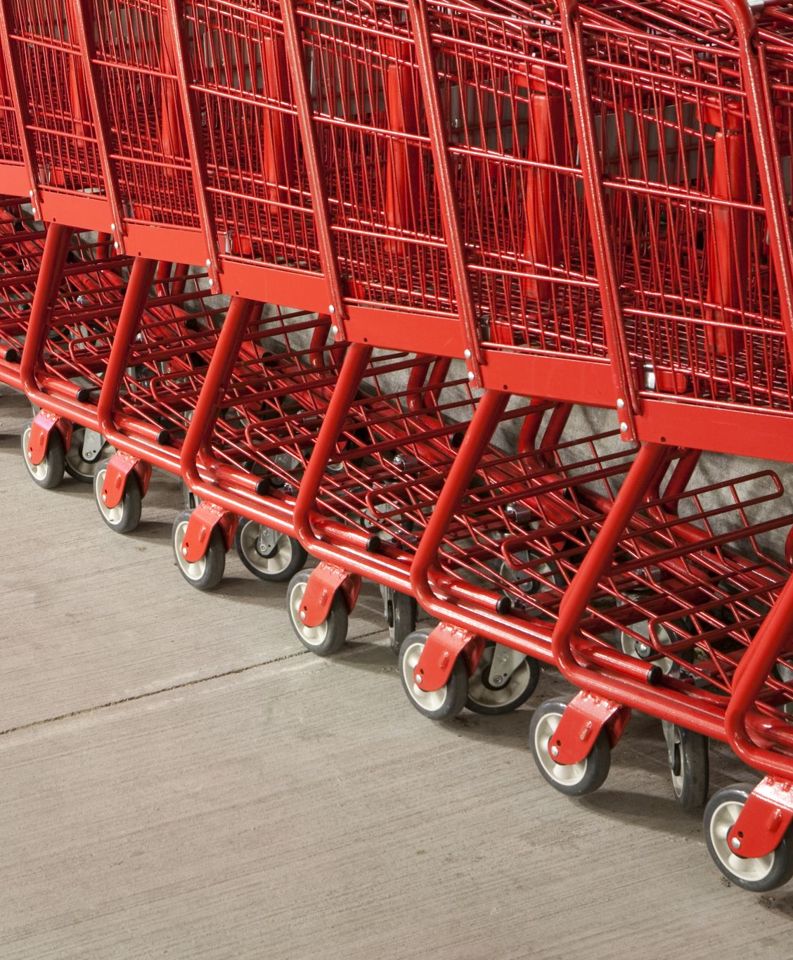
Target Market
There are roughly 134,000 residents in Downtown Dayton
32% of whom are 20 – 39 years old.
As well, 50% of this age range have never been married
We are focusing our efforts on this demographic as there has been a steady trend of consumers this age looking for convenience when shopping and feeling they don’t have time in their day to shop for groceries.
Approximately 65-75% of residents in Dayton Ohio, prefer and/or used delivery options

Slide 5
Forming Brand Identity: 3 Main Focuses
Increasing Local Awareness
Creating In-Store Events/Experiences
Possible Name Change of the Business

Slide 6
Brand Identity: Increase Local Awareness
Many customers have expressed that they never knew what the store was until going inside, and if they knew, they’d be shopping much earlier. On-hand marketing can be highly successful when done correctly
To get those potential customers who never took the time to enter
Display printable flyers and/or business cards in places such as bulletin boards and tables in apartment buildings, laundromats, and coffee shops

Slide 7
Brand Identity: In-Store Events & Experiences
Businesses such as Whole Foods have been very successful at creating an in-store event that has a high retention rate. They host wine tastings with samples of food for customers to try, while making the environment collaborative to meet new individuals.
Forming an event for customers to return to or look forward to is important. There are many variations to achieve this, but some examples:
“$5.00 Fridays”
“Taste Test Tuesdays”

Slide 8
Brand Identity: Business Name Change?
The name of a business is something personal and dear to many owners. However, change can bring more attention to the store
Stop N Save = Grocery?
Make it easily recognizable and comprehensible

Slide 9
Building An Online Presence: 3 Main Focuses
Website
Social Media Accounts
Online Search Image

Slide 10
Building Online Presence: Website
Maintaining a simple & smooth site is important to give off a great first impression and credibility
Google Analytics has shown that the average bounce rate from a business’s landing page is 70% - 90% (Clicking away after entering the website)
However, the average grocery store website only has a bounce rate of 40% - 50%
Important Must-Haves Easily Accessible:
Store Hours & Holiday Hours
Any Business Changes or Upcoming Events
Feedback Mechanism

Slide 11
Building Online Presence: Social Media
Social media is a tool similar to a website, but a more personalized space to interact with the community
Every business has different strategies for running its accounts. It can be comedy, professional, aesthetic, etc. Some ideas to post:
Behind the scenes, in the kitchen, the back, after hours, etc.
Spotlight new products/goods that have come to the store
Positive reviews left about employees or the store
Whatever choice you follow, stick to it! Make it personal, as the store is personal and friendly!

Slide 12
Building Online Presence: Online Search Image
When searching for Stop N Save via Google/Apple Maps, the photos that appear could use some refreshing
As much as people shouldn’t judge off of appearances, it’s an unfortunate thing that we need to consider and plan for this
Google released statistics on business images and stated:
Businesses with quality photos receive 42% more requests for directions and 35% more website clicks

Slide 13
Marketing Content Strategy: 3 Main Focuses
Local Community Engagement
Optimize Online Advertisements
Offline Marketing Tactics

Slide 14
Marketing Strategy: Community Engagement
The state of Ohio has over 2,000 festivals a year, appealing to all different ages, demographics, cultures, hobbies, etc.
Reserving a booth or even crowd surfing at one of these places will be a fantastic way to get your brand and face out there to potential customers
After developing social media profiles, engage back with those who engage with the content.
Host small contests online on customers posting photos and videos of their shopping hauls and meals made with ingredients bought in store

Slide 15
Marketing Strategy: Online Advertisements
Understandably, the marketing budget is limited and is being put to use already. However, there are still things to look for:
Make sure the third party is running them effectively; if outcomes are undesirable, switch gears to another strategy or company altogether
Getting clicks and impressions is important, but if no changes in revenue occur, then something else needs to change with the ads as a result
Take time to ask the right questions. It’s okay to not understand the ins and out’s but by asking them questions on how things are being run, it’ll lead to better understanding of the goals & objectives desired

Slide 16
Marketing Strategy: Offline Tactics
We’ve mentioned using flyers and business cards in heavy foot traffic locations
Days of nice weather, keep the store’s door open with music playing to draw the attention of curious shoppers walking past.
The sidewalks are extra wide, out in front of the store:
Make use of chalk and washable sprays to grab the attention of those walking by who look only down at their phones.

Slide 17
Expanding Brands Reach: 3 Main Focuses
Implement A Delivery System
Offer Order & Pick-up Options
Collaborations With Locals

Slide 18
Expanding Reach: Delivery System
The majority of the market today prefers convenience when shopping to make more use of their time
Companies have exploited this to the fullest and have become even more successful as a result:
Amazon Fresh
Uber Eats
Make the most of Instacart for your store:
In-Store Promotion
Website Accessibility
Usage of grocery delivery services rose 56% since 2022 & 100% increase in curbside or pickup services

Slide 19
Expanding Reach: Order & Pick-Up
BOPIS (Buy Online, Pick Up In-Store) is a fantastic alternative & complement to delivery
A study done by OPI (Optical Phusion, Inc.), who specialize in wireless technology of tablets, kiosks, and barcode scanners, has found:
67% of shoppers in the U.S have used BOPUS in the past 6 Months at least once
75% of these shoppers are more likely to make an additional purchase while picking up their item
Target implemented curbside pick-up in 2020 and saw a 600% increase in sales in the first half of the year and a 500% increase in the second half alone

Slide 20
Expanding Reach: Collaboration With Locals
Content creators, food blogs, and hidden gem exploration accounts have skyrocketed in the past few years
IZEA Worldwide, a company that specializes in marketing technology, has found that today:
Content creators and influencers reach 83% of media users ages 18 – 60
62% of customers trust influencers more than celebrities and the company itself
46% of this audience has made a purchase recommended to them by these individuals

Slide 21
Timeline of Execution
Weeks 1 – 2
Improve photos online on Google/Apple Maps
Brainstorm in-store events & experiences
Come up with possible new names for the business
Weeks 3 – 4
Finalize Instacart setup & begin promotion tactics
Begin consistently uploading to social media on a schedule
Contact festivals and events for marketing
Weeks 5 – 6
Introduce the new events and experiences upon prior preparation
Review existing online ads & reach out to local influencers and blogs
Look into integrating BOPIS to the website and managing the fulfillment of picking orders
Following Months After
Review online ads & their effectiveness:. Adjust them accordingly
Keep expanding on community engagement and more collaboration with content creators
Keep open-minded to more rebranding and changes if needed

Slide 22
Monitoring Success
Brand Identity
Constant feedback upon checkouts & online (Positive and Negative)
Look for what brought them there: Discounts on flyers brought in, word of mouth, etc.
Keep track of sales on days of events are hosted, track attendance via sign-up or motion counter
Online Presence
Get familiar with Google Analytics (it’s free) to help monitor your website. Customer Friendly!
Measure followers per month/week. Judge what posts boost the most engagement
Google Business Insights will allow you to monitor the number of requests for directions and photos viewed
Marketing Content Strategy
If attending events, monitor all who take flyers, try samples, and engage in legit conversations
Continue constant contact with those who are running your current ads to ensure optimization

Slide 23
Conclusion
Focusing on the 4 strategies: Forming Brand Identity, Building an Online Presence, Marketing Content, and Expanding Reach, can give Stop N Save the extra business it desires.
The business is established and has a great foundation, which most businesses desire. With these strategies, it is the perfect step to build off of the existing foundation to grow larger and more successful
Development of a business is forever changing as the world is always changing. With this, you’ll be able to reach customers who may live further or have a busy lifestyle, unable to go to store, while also catering to the loyal customers who make their weekly grocery runs. Always be working towards growing and thinking of new ideas, long after this.

